Slide 1
COMPUTER ARITHMETIC
P.Mohankumar

Slide 2
Digital Hardware Algorithms
Arithmetic operations
Addition, subtraction, multiplication, division
Data types
Fixed-point binary
Signed-magnitude representation
Signed-2’s complement representation
Floating-point binary
Binary-coded decimal (BCD)
P.Mohankumar

Slide 3
Algorithm
When the sign of A & B are identical add the two magnitudes and attach the sign of A to the result.
When the sign of A & B are different compare the magnitudes and subtract the smaller no from the larger.
Choose the sign of the result to be same as A if A>B or the complement of the sign of A if A<B.
If two magnitudes are equal , subtract B from A and make the sign of the result positive.
P.Mohankumar

Slide 4
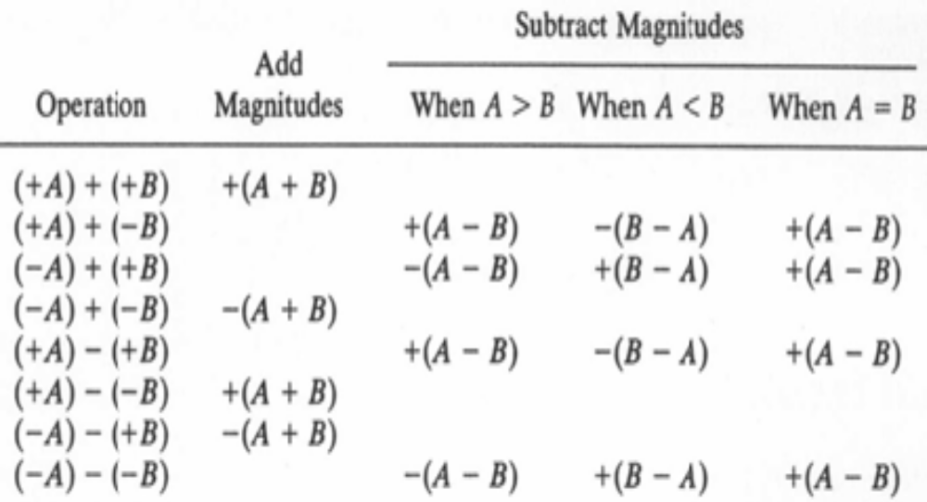
Add / Subtract Signed-Magnitude
P.Mohankumar

Slide 5
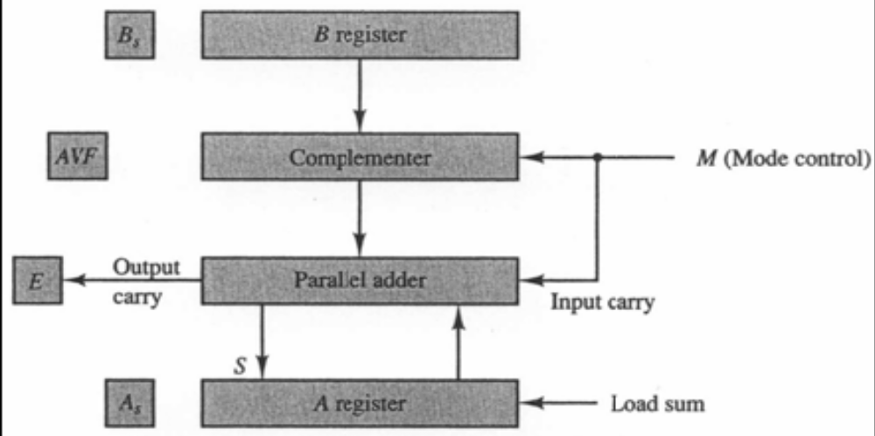
Hardware
P.Mohankumar

Slide 6
Description
􀁺 AS Sign of A
􀁺 BS Sign of B
􀁺 AS & A Accumulator
􀁺 AVF Overflow bit for A + B
􀁺 E Output carry for parallel adder
P.Mohankumar

Slide 7
Flow chart for add and subtract operations
Subtract operation
Add operation
Minuend in A
Subtrahend in B
Augend in A
Addend in B
= 0
A_{S} + B_{S}
= 1
= 1
A_{S} + B_{S}
= 0
A_{S} ≠ B_{S}
A_{S} = B_{S}
A_{S} ≠ B_{S}
A_{S} = B_{S}
EA ← A + B + 1
AVF ← 0
EA ← A + B
= 0
E
= 1
A < B
A ≥ B
AVF ← E
≠ 0
= 0
A ← A
A
A ← A + 1
A_{S} ← A_{S}
A_{S} ← 0
END
(Result in A and A_{S})
P.Mohankumar

Slide 8
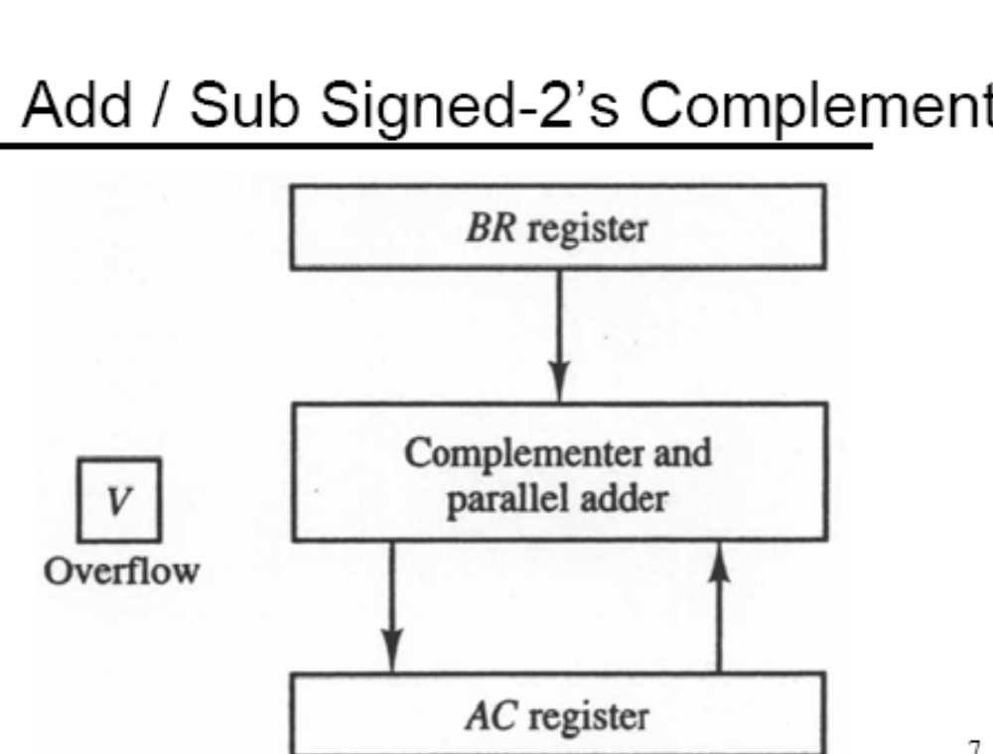
P.Mohankumar

Slide 9

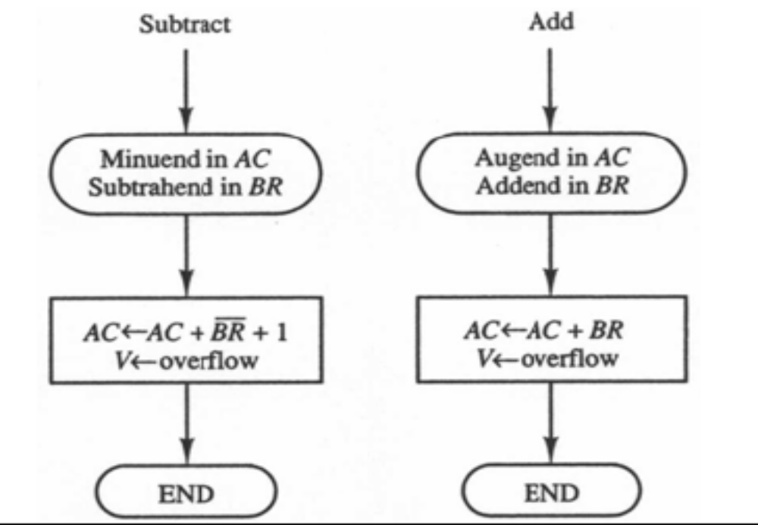
P.Mohankumar

Slide 10

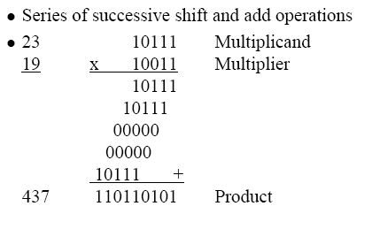
P.Mohankumar

Slide 11
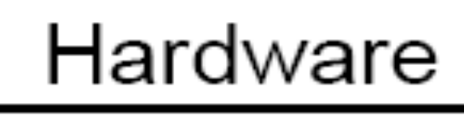
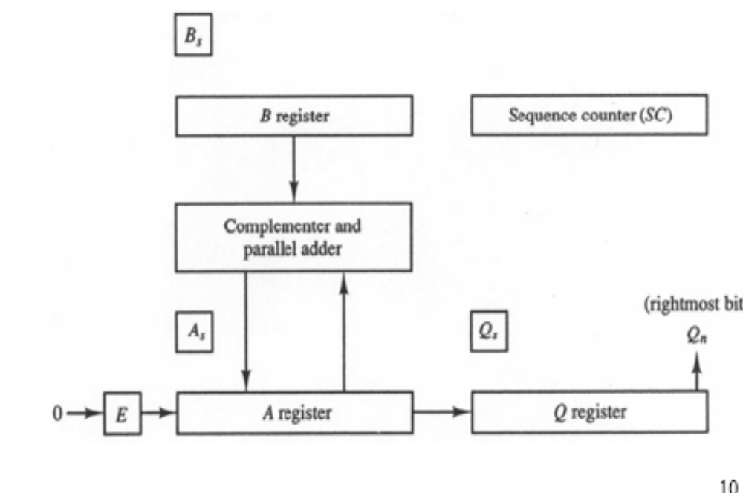
P.Mohankumar

Slide 12
Flow chart for Multiplication (Signed Magnitude Representation)
Multiply Operation
23 × 19 = 437
Q = 19 (10011), B = 23 (10111)
Multiplicand in B
Multiplier in Q
E
A
Q
SC
A_{S} ← Q_{S} + B_{S}
Q_{S} ← Q_{S} + B_{S}
A ← 0, E ← 0
SC ← n – 1
0
00000
10011
101
Add
10111
10111
Shift
0
01011
11001
100
Add
10111
= 0
Q_{n}
= 1
1
00010
Shift
0
10001
01100
011
EA ← A + B
Shift
0
01000
10110
010
Shr EAQ
SC ← SC – 1
Shift
0
00100
01011
001
Add
10111
≠ 0
= 0
11011
SC
Shift
0
01101
10101
000
END
(Product is in AQ)
P.Mohankumar

Slide 13
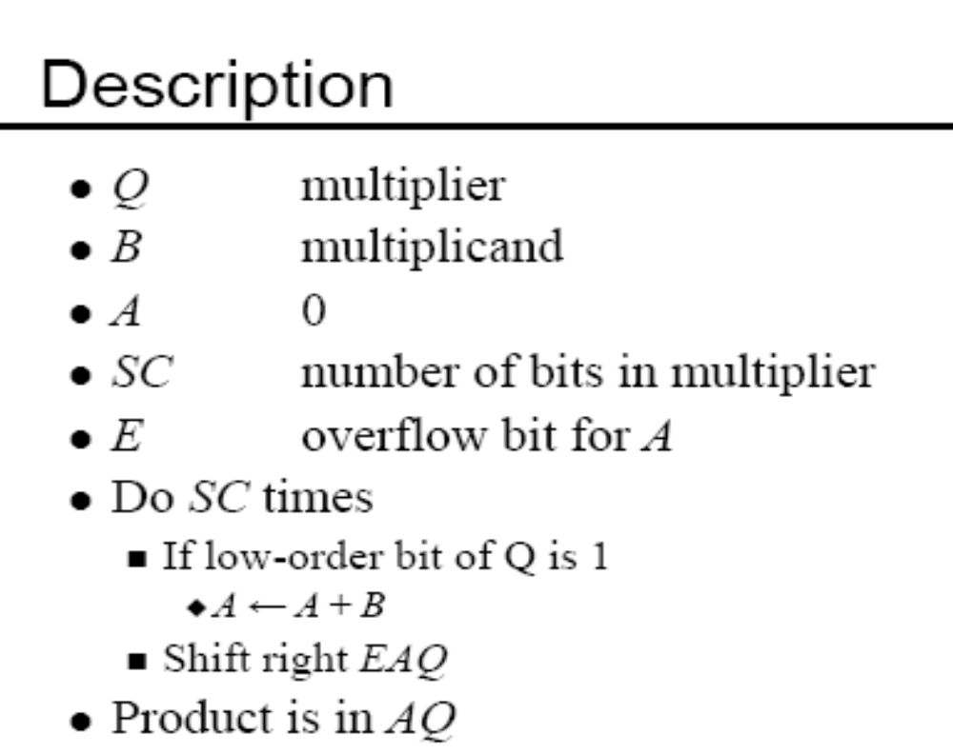
P.Mohankumar

Slide 14

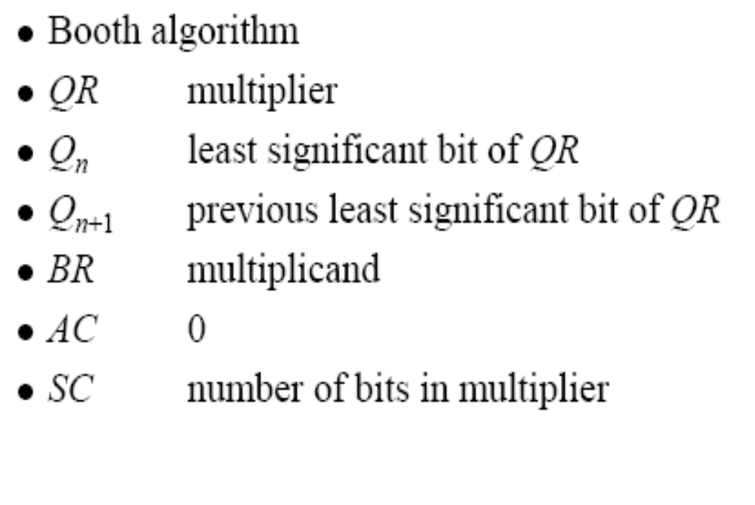
P.Mohankumar

Slide 15
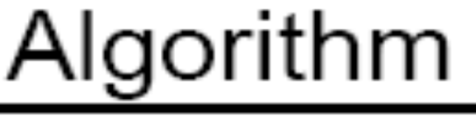
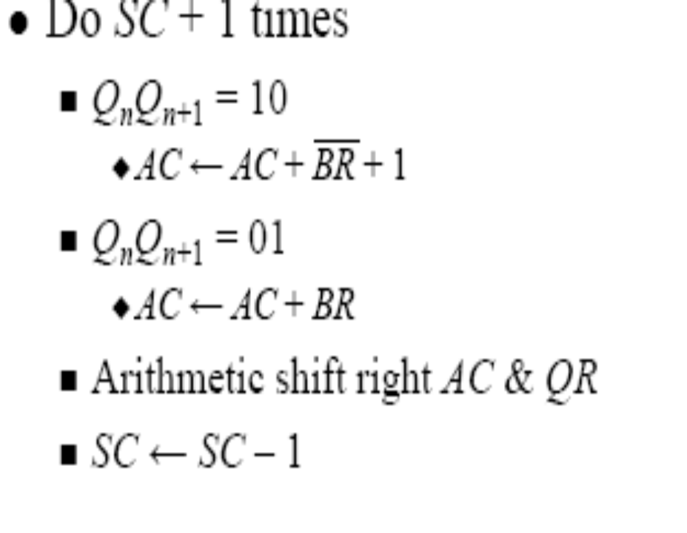
P.Mohankumar

Slide 16
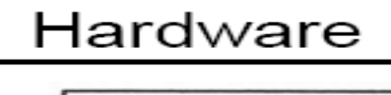
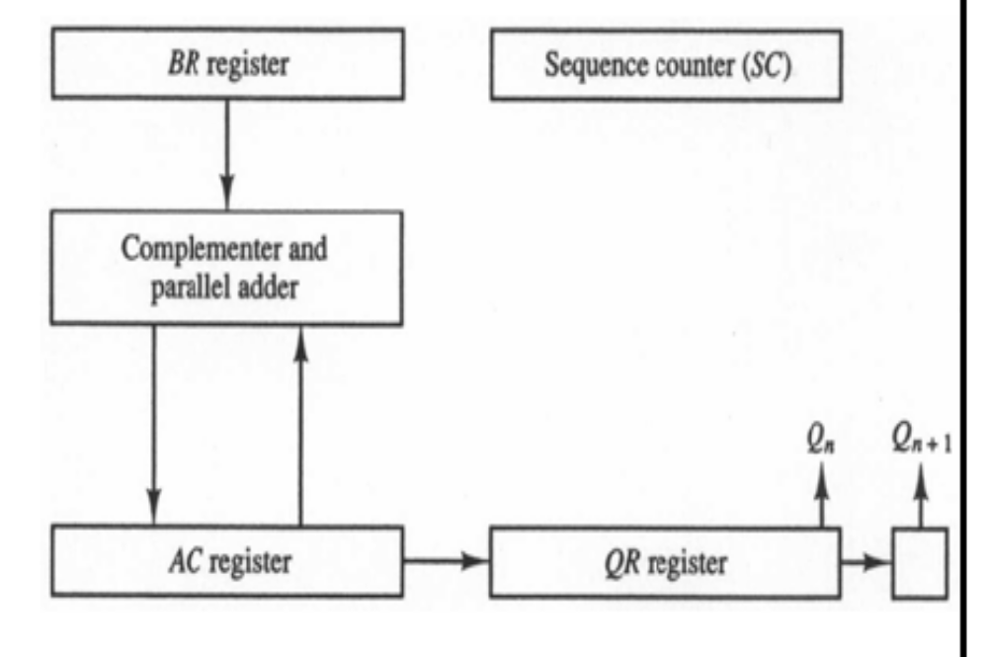
P.Mohankumar

Slide 17
Flowchart for Booth Multiplication
Multiply
Example: -19 × -23 = 437
BR = 10111, BR + 1 = 01001
Multiplicand in BR
Multiplier in QR
Comment
AC
QR
Q_{n+1}
SC
00000
10011
0
5
AC ← 0
Q_{n+1} ← 0
SC ← n
Subtract BR
01001
01001
Ashr
00100
11001
1
4
Ashr
00010
01100
1
3
= 10
= 01
10111
Q_{n}Q_{n+1}
Add BR
11001
AC ← AC + BR + 1
= 00
AC ← AC + BR
Ashr
11100
10110
0
2
= 11
Ashr
11110
01011
0
1
Subtract BR
01001
ashr (AC & QR)
SC ← SC – 1
00111
Ashr
00011
10101
1
0
≠ 0
= 0
SC
P.Mohankumar
END

Slide 18
Binary Division
P.Mohankumar

Slide 19
Example (Paper and Pencil Method)
1
1
0
1
0
Quotient = Q
Divisor:
B = 1 0 0 0 1
0 1 1 1 0 0 0 0 0 0
Dividend = A
0 1 1 1 0
5 bits of A < B, quotient has 5 bits
0 1 1 1 0 0
6 bits of A ≥ B
1 0 0 0 1
Shift right B and subtract; enter 1 in Q
0 1 0 1 1 0
6 bits of remainder ≥ B
1 0 0 0 1
Shift right B and subtract; enter 1 in Q
0 0 1 0 1 0
Remainder < B, enter 0 in Q; shift right B
0 0 1 0 1 0 0
Remainder ≥ B
1 0 0 0 1
Shift right B and subtract; enter 1 in Q
0 0 0 1 1 0
Remainder < B, enter 0 in Q
Final remainder: 000110
P.Mohankumar

Slide 20
Signed magnitude Division Flow chart
Divide operation
Divide magnitudes
Dividend in AQ
Divisor in B
Shl EAQ
Q_{S} ← A_{S} + B_{S}
SC ← n – 1
= 0
E
= 1
EA ← A + B + 1
EA ← A + B + 1
A ← A + B + 1
= 1
A ≥ B
= 1
= 0
E
E
Q_{n} ← 1
A ≥ B
A < B
A < B
= 0
EA ← A + B
EA ← A + B
DVF ← 1
EA ← A + B
DVF ← 0
SC ← SC – 1
SC
≠ 0
END
(Divide Overflow)
= 0
P.Mohankumar
END (Quotient in Q, Remainder in A)

Slide 21
Signed – Magnitude Division
Divisor B = 10001
B + 1 = 01111
Comment
E
A
Q
SC
Dividend:
0 1 1 1 0
0 0 0 0 0
5
Shl EAQ
0
1 1 1 0 0
0 0 0 0 0
Add B + 1
0 1 1 1 1
E = 1
1
0 1 0 1 1
Set Q_{n} = 1
1
0 1 0 1 1
0 0 0 0 1
4
Shl EAQ
0
1 0 1 1 0
0 0 0 1 0
Add B + 1
0 1 1 1 1
E = 1
1
0 0 1 0 1
Set Q_{n} = 1
1
0 0 1 0 1
0 0 0 1 1
3
Shl EAQ
0
0 1 0 1 0
0 0 1 1 0
Add B + 1
0 1 1 1 1
E = 0, leave Q_{n} = 0
0
1 1 0 0 1
0 0 1 1 0
P.Mohankumar
Add B
1 0 0 0 1

Slide 22
Divisor B = 10001
B + 1 = 01111
Comment
E
A
Q
SC
Restore remainder
1
0 1 0 1 0
2
Shl EAQ
0
1 0 1 0 0
0 1 1 0 0
Add B + 1
0 1 1 1 1
E = 1
1
0 0 0 1 1
Set Q_{n} = 1
1
0 0 0 1 1
0 1 1 0 1
1
Shl EAQ
0
0 0 1 1 0
1 1 0 1 0
Add B + 1
0 1 1 1 1
E = 0, leave Q_{n} = 0
0
1 0 1 0 1
1 1 0 1 0
Add B
1 0 0 0 1
Restore remainder
1
0 0 1 1 0
1 1 0 1 0
0
Neglect E
Remainder in A:
0 0 1 1 0
Quotient in Q
1 1 0 1 0
P.Mohankumar

Slide 23
P.Mohankumar

